Slide 1

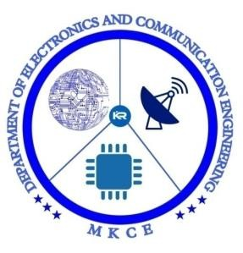
DEPARTMENT OF ELECTRONICS AND COMMUNICATION ENGINEERING
18ECP103l- Minor Project 1
Power Efficient Mini Inverter
Guided by:
Dr.A.Kavitha Professor, ECE
T.Pavithra - 927621BEC144

Slide 2
List of Contents:
▶ Objectives
▶ Abstract
▶ Literature Survey
▶ Block Diagram
▶ Circuit Diagram
▶ Stages of an Inverter
▶ Working Principle
▶ Components Required
▶ Advantage and Disadvantage
▶ References

Slide 3
Objective:
▶ To convert 12V DC to 230V AC ,which is used for Home Appliances like Light,Fan,.etc

Slide 4
Abstract:
▶ The project aims to produce a 12V DC power supply into a 240V AC output by using a transfomer to set up the power.
▶ Also it is capable of producing 1000 watt of
output power.
▶ An Inverter circuit is use to invert the DC
energy into AC.
▶ The circuit is to produce sine wave output with low noise which applies up to 220-240 AC.

Slide 5
Abstract:
▶ In the future we want target to commercialized and go through world market for our projects.
▶ As we know, every project has their advantages and disadvantages , Besides of that we have to reduce the entire disadvantages as much as possible, we might make it useful and easy to use for another people.

Slide 6
Literature Survey:
▶ AC electrical power supply can be used most electronic devices. It will be difficult to use these devices that electrical goes off. This problem can be solved by the use of inverter.
▶ DC to AC converter knows as inverter.This function of inverter is to change DC input voltage to a symmetrical AC output voltage of desired magnitude and frequency.
▶ There are various kind of watt in the inverter according to P=VI. Watt is dependent of the current.The using of watt gets from transformer, coil wire depending on the ampere.

Slide 7
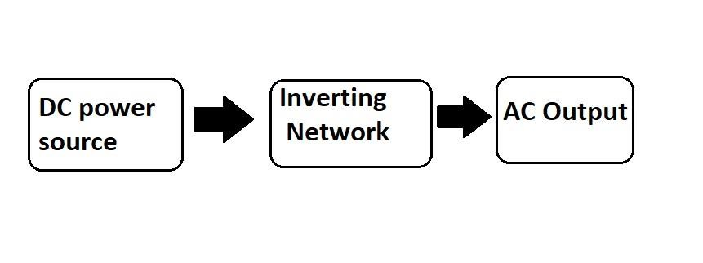
Block Diagram:

Slide 8
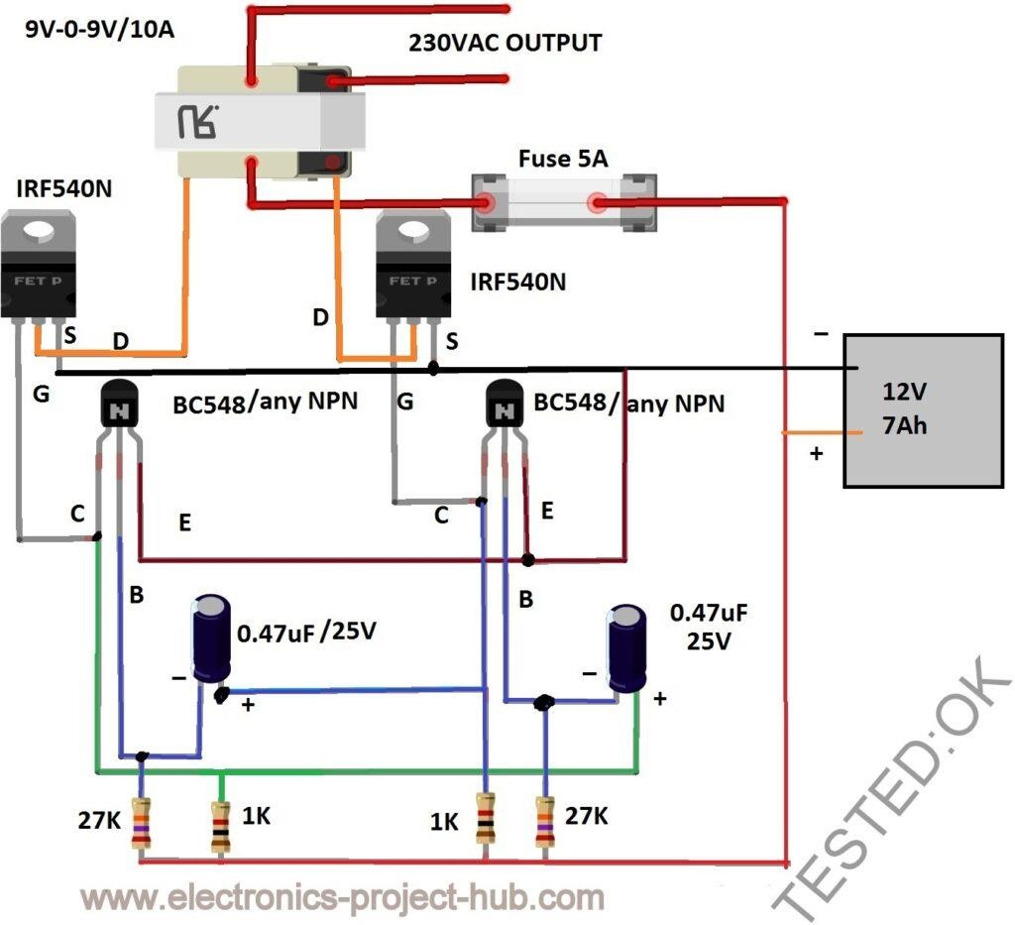

Circuit Diagram:

Slide 9
Stages of an Inverter:
Battery:
▶ The DC power source can be a deep cycle battery or a DC generator or a solar panel. They all gives stable DC power to the inverter.
▶ The voltage to an inverter can be 6V or 12V or 24V or 48V or even 84V, it depends on the inverter’s input specification.

Slide 10
Stages of an Inverter:
Oscillator:
▶ The oscillator is the stage where the constant DC from the battery is converted to AC; we can say this stage as the heart of the Inverter because this generates frequency or pulses like human heart.
▶ The LOW voltage AC is fed to the next stage which is the
driving stage consists of MOSFETs or Transistors.

Slide 11
Stages of an Inverter:
Driving Stage:
▶ The oscillating stage just gives oscillating AC weak signal which
cannot be fed to a transformer to boost the voltage.
▶ The driving stage increases the strength of the oscillating AC signal.
▶ The driving stage consists of MOSFETs or Transistors. Most commercial Inverters are packed with MOSFETs for driving stage because it is very efficient in switching, less resistance path between source and drain terminal which translates to less heat.

Slide 12
Stages of an Inverter:
Transformer:
▶ The transformer is the component which converts Low voltage AC to high voltage AC.
▶ The amplified AC signal from the driving stage is strong and ready to feed the transformer. The transformer can be with centre tap or without centre tap.

Slide 13
Working Principle:
▶ Inverters convert low frequency main AC power to higher frequency for use in induction heating.
▶ To do this, AC power is first rectified to provide DC power.
▶ The inverter then changes the DC power
to high frequency AC power.

Slide 14
Components Required:
BC548 / Any NPN Transistor x 2
27K ohm x 2
1K ohm x 2
0.47 uF x 2 – Electrolytic or ceramic
MOSFET IRF540N or any N-channel MOSFET x2
Transformer 9V-0-9V / 10A (At-least 5A)
Fuse 5A (For short circuit protection of battery)
12V 7Ah Battery

Slide 15
Advantages:
▶ Simple design can be built by beginners.
▶ Decent efficiency around 75 to 80%.
▶ Stable frequency around 50 to 60 Hz.
▶ Well tested circuit.

Slide 16
Disadvantages:
▶ Output voltage varies as the load increases.
▶ Square wave is not suitable for sensitive electronic gadgets such as medical equipments.

Slide 17
References:
Power Rectifiers, Inverters, and Converters – Accelerated Steady- State Approaches with Closed-Form Solutions.
- by Keng Wu
Charge Controller and Inverter.
-by Hadaate Ullah

Slide 18


